Slide 1

Whose Team Are You On?
DSC 680 Applied Data Science
Project 1 Michael Loos
Notes:
.

Slide 2
Agenda
Background
Proposal
Data
Methods
Analysis
Conclusion

Slide 3
Background
Media outlets often publish stories with photos, especially sporting events
National or regional outlets could be covering many games
Photos need to be paired with stories, teams, etc.
Is there a way to automate this process?

Slide 4
Proposal
Convolutional neural networks, or convnets, are nearly universally used for computer vision applications
Use a convolutional neural network to classify images of Big Ten teams
The model would reduce manual work to sort images

Slide 5
Data
Source: Google Images
Selenium Web Driver
Obtained ~500 photos for each team
Split into training (60%), validation (20%), and test (20%) sets
Teams:
Illinois Fighting Illini
Indiana Hoosiers
Iowa Hawkeye
Maryland Terrapins
Michigan Wolverines
Michigan State Spartans
Minnesota Gophers,
Nebraska Cornhuskers
Northwestern Wildcats
Ohio State Buckeyes
Penn State Nittany Lions
Purdue Boilermakers
Rutgers Scarlet Knights
Wisconsin Badgers

Slide 6
Methods
Python was used to create and train the convnet
Model
Four stages of 2D convolution layers paired with MaxPooling layers
Relu activation
Flatten layer
Two Dense layers
Softmax activation
14 outputs, one for each team
Generators were used to input images into the model
Images were augmented

Slide 7
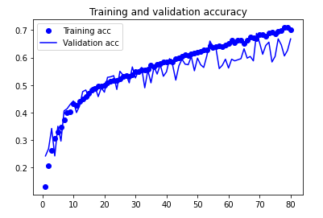
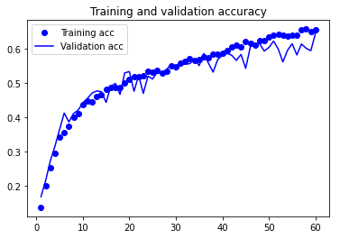
Training
Initial training done with 80 epochs and 200 steps per epoch
70% accuracy on training dataset
67% accuracy on validation dataset
Model was retrained with 60 epochs
66% accuracy on training dataset
64% accuracy on validation dataset

Slide 8
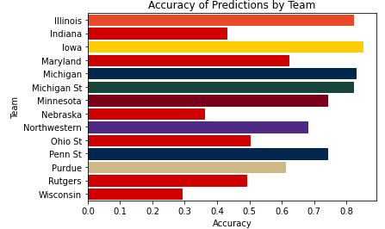
Analysis
Evaluation
63% accuracy on test data set
Accuracy varied by team
Model struggled with teams whose primary color is red

Slide 9
Conclusion
Model was able to classify images at a rate nine times greater than random guess
Uses
Classifying images at large scale
Retrain model using wider range of teams
Implementation
Set up model to process and classify images received at specific location
Ethical issues
Data scraping
Image ownership
Name, Image, and Likeness (NIL)

